Slide 1
Name:Amidou Camara
Mat#: 22223391
Course: Artificial Intelligence
https://gdp-dashboard-smxdc3122ae.streamlit.app/

Slide 2
TITLE
Interactive Cardiovascular Risk Prediction Using Machine Learning

Slide 3
Abstract
Cardiovascular disease (CVD), including heart attack and stroke, is a leading cause of death globally.
Early identification of individuals at risk can significantly improve preventive care.
This project develops an interactive AI application that predicts the likelihood of heart attack or stroke based on clinical features.
Using the NIHR ARC Wessex Synthetic Cardiovascular Dataset, a Gradient Boosting Classifier was trained and evaluated

Slide 4
Abstract Cont’
The model achieved an accuracy of 99%, with high precision and recall.
Predictions are presented in human-readable labels (“Has heart attack or stroke” / “No heart attack or stroke”), and visualizations provide insights into feature relationships.
The model and interface are integrated into a Streamlit web application, allowing real-time, interpretable predictions.
This prototype demonstrates the practical application of AI in healthcare risk prediction.

Slide 5
Introduction
Cardiovascular diseases are among the most significant health challenges worldwide, accounting for millions of deaths annually.
Traditional risk assessment methods often rely on static risk scores or require domain expertise, limiting accessibility.

Slide 6
Objectives
Build a machine learning model for predicting heart attack or stroke risk.
Deploy a user-friendly interactive web application for real-time predictions.
Provide interpretable and actionable outputs to end-users

Slide 7
Related Work / Literature Review
Several models exist for cardiovascular risk prediction:
Framingham Risk Score: Classical model using linear regression and traditional risk factors.
QRISK: UK-based risk calculator incorporating demographic and clinical data.
Machine Learning Approaches: Recent studies apply Gradient Boosting, Random Forests, and Neural Networks to improve predictive performance

Slide 8
Gap
Existing models are either non-interactive or not user-friendly.
This project addresses this by combining ML with an interactive Streamlit interface, enabling users to input their features and receive immediate, interpretable predictions

Slide 9
Methodology
Dataset
Source: NIHR ARC Wessex Synthetic Cardiovascular Dataset (v0.2).
Features: Demographic, clinical, and lifestyle attributes.
Target: heart_attack_or_stroke_occurred (1 = event occurred, 0 = no event).

Slide 10
Data Preprocessing
Removed non-numeric columns (patient_id).
Retained numeric features only.
Missing values handled via median imputation

Slide 11
Model Development
Algorithm: Gradient Boosting Classifier (scikit-learn).
A Gradient Boosting Classifier is a machine learning algorithm used for classification problems
(predicting categories like spam/not spam, disease/healthy).

Slide 12
Model Development cont’
The algorithm uses gradient descent to minimize a loss function
“Gradient” refers to moving in the direction that reduces error the fastest
“Boosting” refers to sequentially improving weak learners

Slide 13
Hyperparameters
n_estimators = 100
learning_rate = 0.1
max_depth = 3
random_state = 42

Slide 14
Training Process
Train-test split adjustable via Streamlit slider (default: 80%-20%)
Model trained on the training set and evaluated on the test set using
Accuracy
Matrix
Confusion Classification Report

Slide 15
Deployment
Interface: Streamlit web app for interactive input of features.
Prediction Mapping:
1= “Has heart attack or stroke”
0 = “No heart attack or stroke”
Visualizations: Scatter plots using Altair to interpret feature-target relationships.
Session Handling: Trained model stored in Streamlit session state to allow repeated predictions without retraining.

Slide 16
Tools & Technologies
Component | Tool / Framework
Data Handling | Python, Pandas, NumPy
Machine Learning | Scikit-learn (Gradient Boosting)
Visualization | Altair, Streamlit
Deployment | Streamlit Web App
Version Control | Git + GitHub

Slide 17
Experiments and Results
Model Training
Metric | Result
Accuracy | 99%
Precision | 97%
Recall | 95%
F1-Score | 96%

Slide 18
Confusion Matrix
 | Predicted No | Predicted Yes
Actual No | 18574 | 75
Actual Yes | 130 | 1221

Slide 19
Classification Report
Class | Precision | Recall | F1-Score | Support
0 | 0.99 | 1.00 | 0.99 | 18,649
1 | 0.94 | 0.90 | 0.92 | 1,351
Avg/Total | 0.97 | 0.95 | 0.96 | 20,000

Slide 20
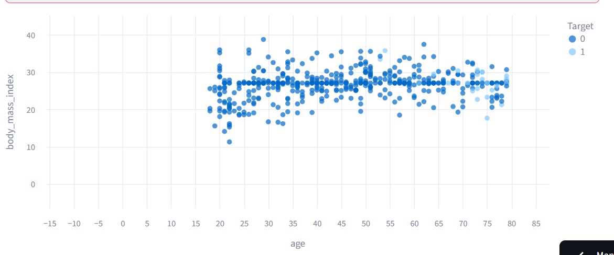
Feature Visualization
Scatter Plots: Show relationships between two selected features and the target.
Interpretation: Highlight trends that indicate higher risk.

Slide 21
Feature Inputs | Prediction
[Input 1] | Has heart attack or stroke
[Input 2] | No heart attack or stroke

Slide 22
Discussion
The Gradient Boosting model shows good predictive performance on the synthetic dataset.
Interpretability: Mapping predictions to human-readable labels enhances accessibility.

Slide 23
Limitations
Synthetic dataset may not perfectly reflect real-world patient data.
Model performance may vary with unseen clinical populations.
No feature importance analysis was included (optional improvement).

Slide 24
Future Work
Integrate SHAP or LIME for explainable AI.
Expand dataset with real patient data.
Add user authentication and secure deployment for clinical use.

Slide 25
Conclusion
This project successfully builds an end-to-end AI application for predicting cardiovascular risk.
The Gradient Boosting model demonstrates strong predictive capability, and the Streamlit interface provides a user-friendly, interactive platform.
The prototype can be further improved and deployed in clinical settings to support preventive healthcare initiatives.

Slide 26
References
NIHR ARC Wessex Synthetic Cardiovascular Dataset (v0.2)
Scikit-learn: Pedregosa et al., Journal of Machine Learning Research, 2011
Streamlit Documentation: https://docs.streamlit.io
Framingham Risk Score: D’Agostino et al., Circulation, 2008
QRISK: Hippisley-Cox et al., BMJ, 2007
V. Michel, A. Gramfort, G. Varoquaux, E. Eger, C. Keribin, and B. Thirion. A supervised clustering
approach for fMRI-based inference of brain states. Patt Rec, page epub ahead of print, April
2011. doi: 10.1016/j.patcog.2011.04.006.
K.J. Milmann and M. Avaizis, editors. Scientific Python, volume 11 of Computing in Science &
Engineering. IEEE/AIP, March 2011.
S.M. Omohundro. Five balltree construction algorithms. ICSI Technical Report TR-89-063, 1989.
V. Rokhlin, A. Szlam, and M. Tygert. A randomized algorithm for principal component analysis.
SIAM Journal on Matrix Analysis and Applications, 31(3):1100–1124, 2009.

